Slide 1
420-D04-SU
Object-oriented programming I Java I
Introduction

Slide 2


Java
Java is a very widely used programming language.
It is a modern programming language, developed by Sun Microsystems, which has since been acquired by Oracle.
Don’t confuse Java with JavaScript.
Java’s biggest strength is its excellent portability.
Windows
Mac
Linux
Android
Etc…

Slide 3
Java
Can make console applications, or window applications with a graphical user interface (GUI)
Java Standard Edition (Java SE)
AWT, Swing, JavaFx
Can make programs incorporated into websites: applets
Java SE
Can make web applications (Java II / Java III courses)
Java Enterprise Edition (Java EE)
Can make mobile apps
Java Micro Edition (Java ME)
Android

Slide 4

Java
Java is a high-level programming language. The following are some main characteristics of the language:
Simple
Object-oriented
Class-based
Distributed
Multithreaded
Dynamic
Platform independent
Architecture neutral
Portable
High performance
Robust
Secure

Slide 5
Version history
The numbering of versions is somewhat irregular.
JDK 1.0
JDK 1.1
J2SE 1.2 (Java 2)
J2SE 1.3 (Java 2)
J2SE 1.4 (Java 2)
Java SE 5 (1.5)
Java SE 6
Java SE 7
Java SE 8
Java SE 9
Java SE 10
Java SE 11
Java SE 12

Slide 6
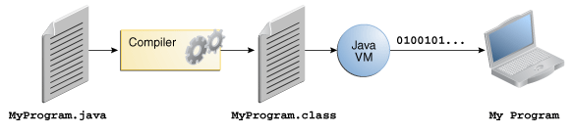
Java
Java source code is stored in .java files (in human-readable language).
The compiler (javac) transforms the .java source files into .class files, containing bytecode, a language that can be interpreted by the Java Virtual Machine (JVM).
The program is launched from an instance of JVM.

Slide 7
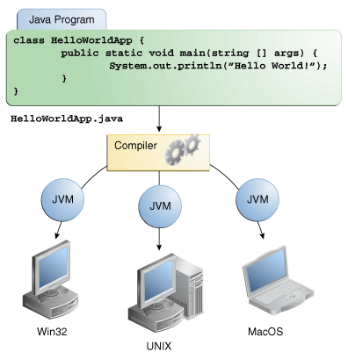
Portability

Slide 8
Key acronyms
JVM (Java Virtual Machine)
Enables computer to execute Java programs.
JVM available for many operating systems.
JRE (Java Runtime Environment)
Primarily contains:
a JVM
the Java standard library (JCL: Java Class Library)
JDK (Java Development Kit)
This SDK (Software Development Kit) contains:
The JRE
A compiler, javac (translates Java source code into bytecode)
An interpreter/loader, java
A debugger
Other development tools

